Slide 1

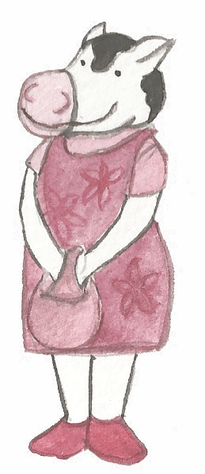
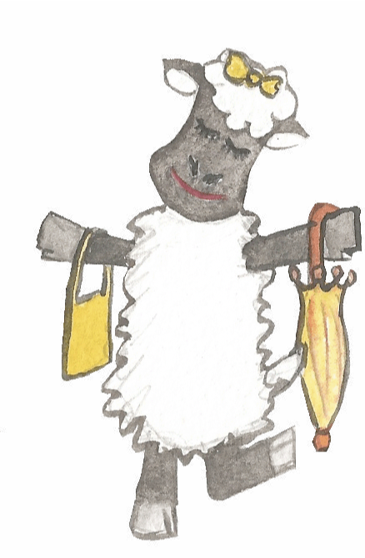
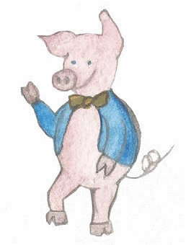
Adverbs
and how to use them

Slide 2
Adverbs
Adverbs can tell us more about a verb.
happily
reluctantly
willingly
usually
yesterday
. . . the sheep went to market.

Slide 3
Verbs
Verbs indicate that someone or something is
doing, feeling or being.
The cow moos.
The sheep bleats.
A pig snuffles.
I cover my ears!
Usually verbs have the name of a person or thing or a pronoun in front of them.

Slide 4
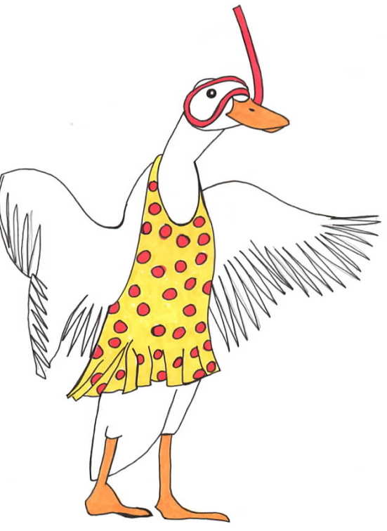
Adverbs
Adverbs tell us more about a verb.
The duck dives.
The duck dives swiftly.
The duck dives deeply.
The duck absolutely refuses to dive.
In each sentence, the verb is modified by the adverb.

Slide 5
Adverbs
Adverbs can also tell us more about an adjective.
The cow went to market.
happy
The happy cow went to market.
usually
The usually happy cow went to market.
See how adverbs can change the meaning. . .

Slide 6
Adjectives
Adjectives add information about a noun.
A noun is a naming word.
happy
The happy cow moos.
The cow moos.
The sheep bleats.
A pig snuffles.
The farmer’s daughter covers her ears!
The angry sheep bleats.
angry
The noisy pig snuffles.
The farmer’s daughter covers her sore ears.
greedy
calm
sore
noisy
Choose an adjective to describe yourself!

Slide 7
Adverbs
Adverbs tell us more about an adjective.
The pig went to market.
unaware
The unaware pig went to market.
clearly
The clearly unaware pig went to market.
The happily unaware pig went to market.
happily
The apparently unaware pig went to market.
apparently
Consider how the meaning has changed.

Slide 8
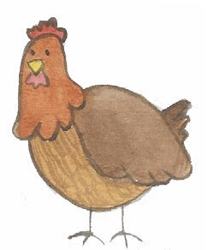
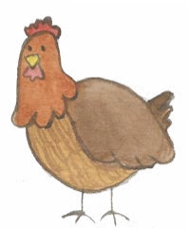
Punctuating Adverbs
When an adverb is at the front, we use a comma.
Loudly, the chickens squawked a warning.
When an adverb is beside the verb, we do not usually need a comma.
The chickens loudly squawked a warning.
It’s YOUR decision where to place the adverb.

Slide 9
Adverbs
Adverbs can tell us more about a verb
or an adjective.
We love the peaceful cow.
We love the peaceful cow.
We definitely love the peaceful cow.
We love the totally peaceful cow.
Modify the verb with an adverb
Modify the adjective with an adverb
The chicken crossed the dangerous road.
The chicken stupidly crossed the very dangerous road.
Possible answer

Slide 10

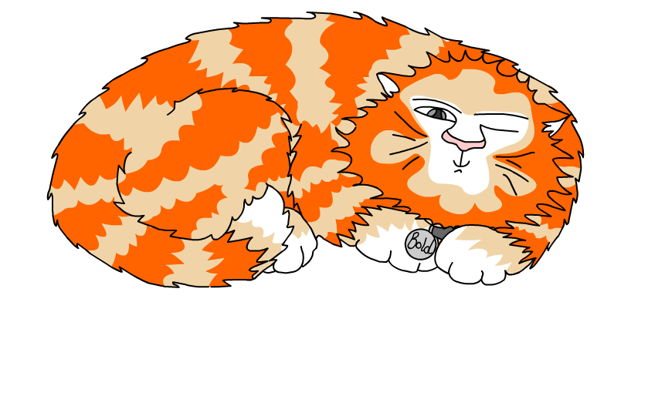
Explore more Hamilton Trust Learning Materials at https://wrht.org.uk/hamilton/ .

