Slide 1
Keep Calm and Make Music
Weekly Wonder
Journey to the Moon KS1

Slide 2
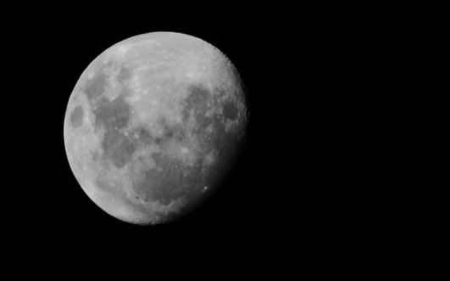
Journey to the Moon
Listen to Telstar
and imagine
you are in a
rocket on your
way up to the
moon

Slide 3
Whatever Next
Click to listen to Whatever Next

Slide 4
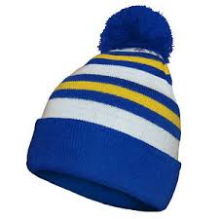
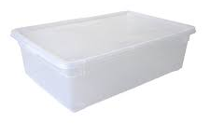
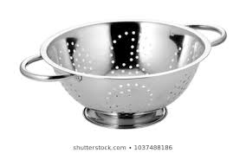
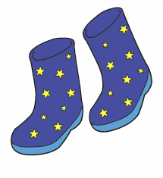
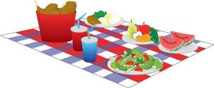
Go on your own moon journey
First find your space equipment, (don’t forget to ask a grown up before you take anything)
You will need:
a rocket a helmet
space boots a picnic

Slide 5
Make a rocket out of a box/ laundry basket/ something else …
Sit in your rocket Is it comfy or does it need a seat?
Perhaps some books or a cushion to sit on?
How will you steer your rocket? Do you need a steering wheel and some control buttons? Can you draw or make these?
Choose some sounds for your rocket. Make some vocal sounds for pressing the control, turning the engine on, taking off etc…
Brrrr
whoosh
Ping pong

Slide 6
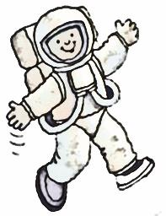
Try out your moon boots
Put your moon boots on
Click here to watch how astronauts move on the moon
Walking on the Moon This song is all about walking on the moon
Have fun walking like an astronaut in your moon boots to this fun song

Slide 7
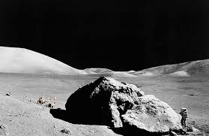
What will the moon be like?
Listen to Alpha by Vangelis Choose some words to describe the moon
lonely
dusty
dark
spooky

Slide 8
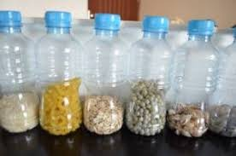
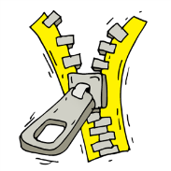
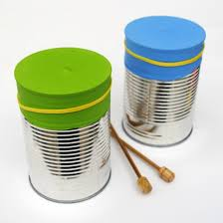
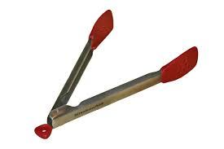
Play some moon music
Find or make some sounds to match your describing words then use them
to play along to Alpha

Slide 9
Let’s go to the moon!
Pack your rocket
(don’t forget your space music sounds and your picnic)
Put on your moon boots and helmet
Climb in and prepare for take off

Slide 10
Take off!
Turn your switches on (make your switching on sounds)
Turn your engine on (make your engine sound)
Count down to take off: 10 9 8 7 6 5 4 3 2 1
Blast off! (make your taking off sound)
Then listen to Telstar by the Tornados as you fly up to the moon

Slide 11
Enjoy your visit to the moon
Go exploring in your moon boots – moon walk to Walking on the Moon again
Play your own moon music along to Alpha
Eat your picnic whilst listening to some space music
Climb back into your rocket and blast off for home

Slide 12
Fly home
Listen to Telstar by the Tornados as you fly back home
Land with a bump then turn off your engine and climb out of your rocket
Hope you had fun!

Slide 13
Still got time?
Use some free online resources to explore choosing and playing space sounds
Here is a link to a site with virtual musical instruments:
https://www.virtualmusicalinstruments.com/
The virtual pan pipes have a particularly “spacey” sound. Use the number keys on your computer keyboard to play more than one sound at the same time
If you have an iPhone or iPad you could use this free app:
Marimba, Xylophone, Vibraphone The vibraphone setting sounds really “spacey”

Slide 14
Still got even more time? Listen to some other music inspired by outer space
Also Spracht Zarathustra by Richard Strauss This was the music used by NASA
Fanfare for the Common Man by Copland
Rocket Man by Elton John
Final Countdown by Europe Buzz Aldrin Rocket Experience – rapped by Buzz Aldrin

